Slide 1
01 | An Introduction to Machine Learning and AzureML Studio

Slide 2
Module Overview
Machine Learning Overview
AzureML Strengths
Microsoft Azure Overview, Getting an Account and Using Storage Accounts
Setting up an AzureML Workspace
Exploring AzureML Studio

Slide 3




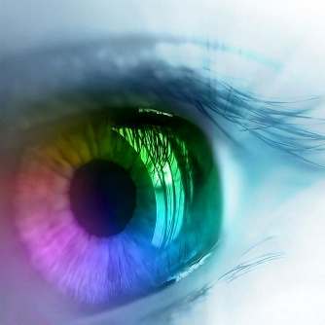







Machine Learning / Predictive Analytics
Machine learning & predictive analytics are core capabilities that are needed throughout your business
Churn analysis
Social network analysis
Recommenda-tion engines
Location-based tracking and services
Vision Analytics
Weather forecasting for business planning
Legal discovery and document archiving
Equipment monitoring
Advertising analysis
Pricing analysis
Fraud detection
Personalized Insurance

Slide 4
Machine Learning Overview
Formal definition: “A computer program is said to learn from experience E with respect to some class of tasks T and performance measure P, if its performance at tasks in T, as measured by P, improves with experience E” - Tom M. Mitchell
Another definition: “The goal of machine learning is to program computers to use example data or past experience to solve a given problem.” – Introduction to Machine Learning, 2nd Edition, MIT Press
ML often involves two primary techniques:
Supervised Learning: Finding the mapping between inputs and outputs using correct values to “train” a model
Unsupervised Learning: Finding patterns in the input data (similar to Density Estimates in Statistics)

Slide 5
Machine Learning
Data:
A B C D E F G H I J K L M N O P Q R S T U V W X Y Z
Rules, or Algorithms:
about, Learning, language – Spelling and sounding builds words
Learning about language. – Words build sentences
Learning, or Abstraction:
Any new understanding proceeds from previous knowledge.

Slide 6
Supervised Learning
Used when you want to predict unknown answers from answers you already have – requires data which shows the answers you can get now
Data is divided into two parts: the data you will use to “teach” the system (data set), and the data you will use to see if the computer’s algorithms are accurate (test set)
After you select and clean the data, you select data points that show the right relationships in the data. The answers are “labels”, the categories/columns/attributes are “features” and the values are…values.
Then you select an algorithm to compute the outcome. (Often you choose more than one)
You run the program on the data set, and check to see if you got the right answer from the test set.
Once you perform the experiment, you select the best model. This is the final output – the model is then used against more data to get the answers you need

Slide 7






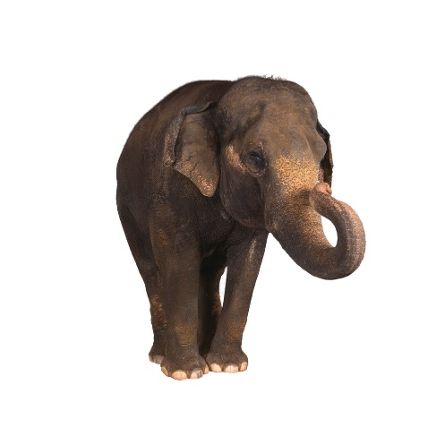
Supervised Learning
Car
Not Car

Slide 8
Unsupervised Learning
Used when you want to find unknown answers – mostly groupings - directly from data
No simple way to evaluate accuracy of what you learn
Evaluates more vectors, groups into sets or classifications
Start with the data
Apply algorithm
Evaluate groups

Slide 9
Unsupervised Learning
Example 1 example A Example 2 example B Example 3 example C
example A | example B | example C
Example 1 | Example 2 | Example 3

Slide 10
AzureML
Why AzureML?
Setting up a Microsoft Azure Account
Setting up a Storage Account
Loading Data
Setting up an AzureML Workspace
Accessing AzureML Studio
AzureML Studio Tour

